Slide 1
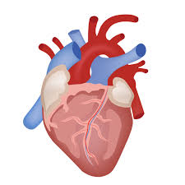
Heart
Dr Tampaki Ekaterini Christina, Plastic and Reconstructive Surgeon
Dr Filippou Dimitrios, Assistant Professor - General Surgeon
Dr Sinou Natalia, PhD candidate

Slide 2
Heart
The heart is often described as the central component of the cardiovascular system
It is a vital organ that has a complex structure made of cardiac tissue and embedded vessels
Muscular organ that pumps blood around the body with the pulmonary and systemic circulation.
Serves to collect deoxygenated blood from all parts of the body, carries it to the lungs to be oxygenated and release carbon dioxide. Then, it transports the oxygenated blood from the lungs and distributes it to all the body parts.

Slide 3
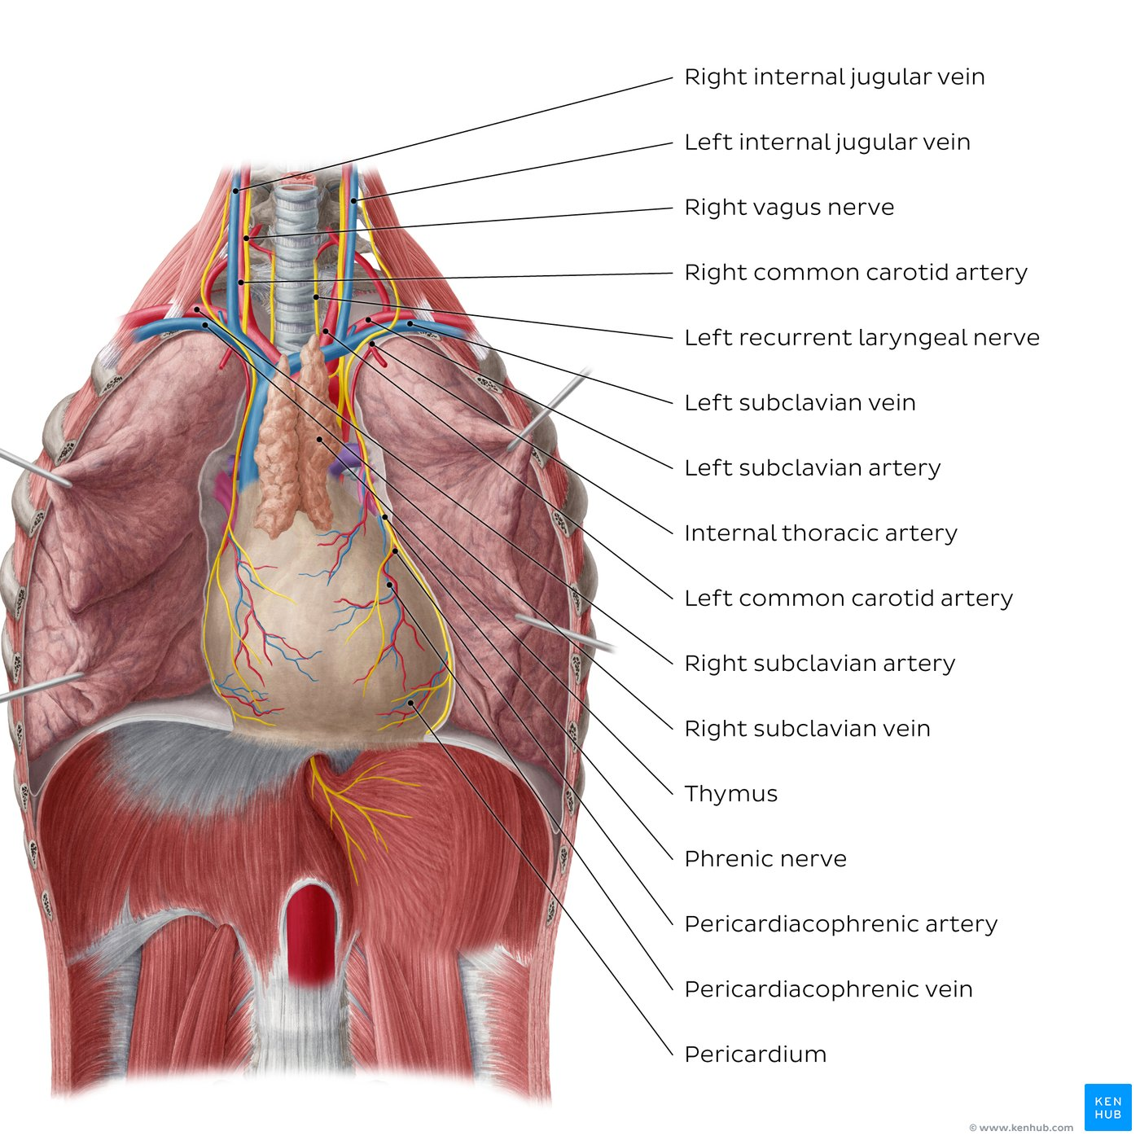
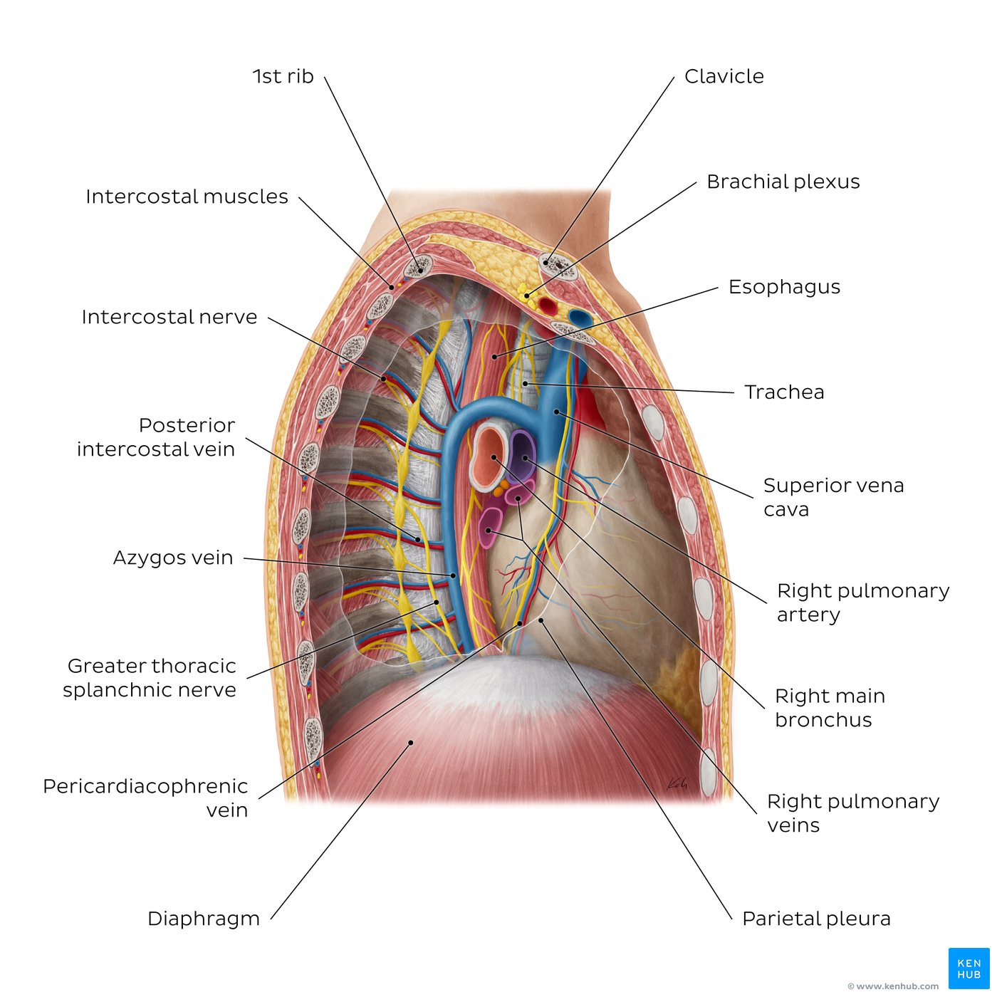
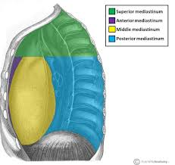
Mediastinum
It is a thick movable partition between the two pleural sacs & lungs. It contains all the structures which lie in the intermediate compartment of the thoracic cavity.
The mediastinum is a compartment of the thorax located in the midline of the body, that contains most of the thoracic viscera, apart from the lungs. It extends vertically from the superior thoracic aperture to the diaphragm and is bounded laterally by the medial surfaces of the pleura.
The thoracic plane (of Ludwig), is an imaginary line extending from the sternal angle, anteriorly, to the T4-T5 intervertebral space, posteriorly. This plane divides the mediastinum into superior (above the thoracic plane) and inferior (below the thoracic plane) mediastinal divisions.
The inferior division is further subdivided into anterior, middle and posterior compartments by the pericardial sac. Structures located anterior to the pericardial sac belong to the anterior mediastinum, whereas those located posterior to pericardial sac are said to be structures of the posterior mediastinum. Those located in and around the pericardial sac belong to the middle mediastinum.
Some structures course longitudinally both through the superior and inferior mediastinum: esophagus, azygos veins and vagus and phrenic nerves.

Slide 4
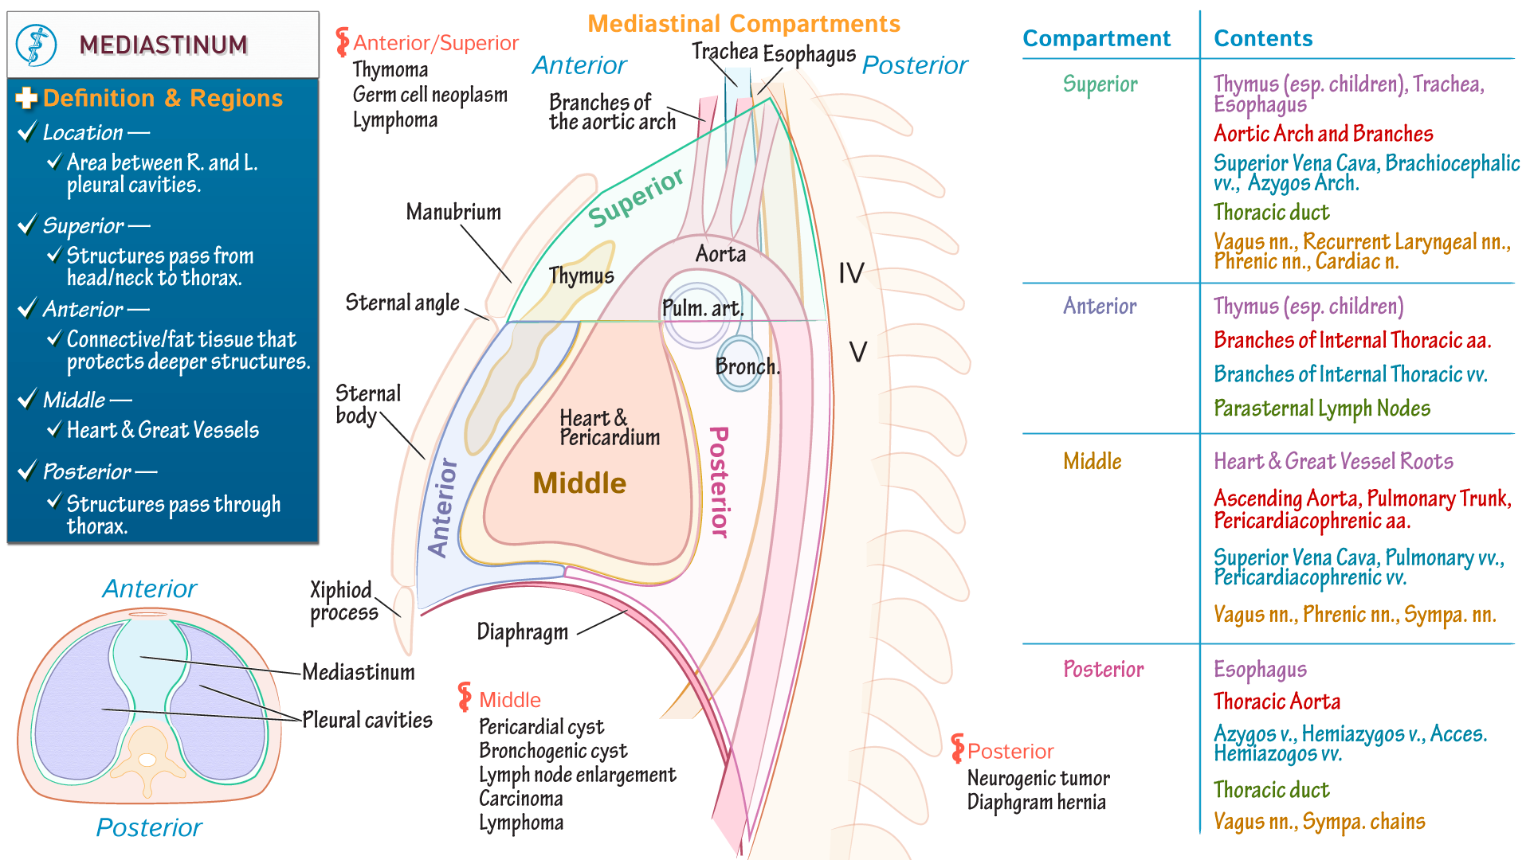
Division of the mediastinum
Borders | Superior: Superior thoracic aperture (delineated by the manubrium of the sternum, superior border of the first rib and body of vertebra T1) Inferior: Diaphragm Anterior: Sternum and costal cartilages of 1st-5th ribs Posterior: Vertebral bodies of superior thoracic vertebrae Lateral: Parietal pleura of each lung
Divisions | Thoracic plane: Extends from sternal angle to vertebrae T4/5 intervertebral space Superior mediastinum: Above thoracic plane Inferior mediastinum: Below thoracic plane, further subdivided into anterior, middle and posterior compartments, according to relations with pericardial sac
Contents | Superior mediastinum: Thymus, trachea, superior part of superior vena cava, aortic arch and its branches (brachiocephalic trunk, left common carotid artery and left subclavian artery, esophagus Anterior mediastinum: Some remnants of the thymus Middle mediastinum: Pericardial sac and heart; roots of superior and inferior vena cava; pulmonary trunk, arteries and veins; root of aorta; main bronchi; pericardiacophrenic arteries and veins Posterior mediastinum: Descending thoracic aorta and its branches; azygos veins, esophagus
Every compartment of the mediastinum contains many vital organs, vascular and neural structures that are closely related one to another. Such a rich content of the mediastinum indicates its significance from the aspect of the anatomy.

Slide 5
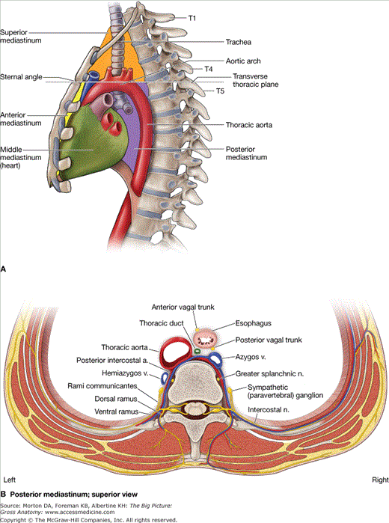
Key points about the neurovasculature of the posterior mediastinum.
Arteries | Descending thoracic aorta and its branches (pericardial branches, bronchial branches, esophageal branches, mediastinal branches, posterior intercostal arteries, superior phrenic artery, subcostal artery)
Veins | Azygos system of veins (azygos vein, hemiazygos vein, accessory hemiazygos vein), posterior intercostal veins, esophageal veins
Nerves | Sympathetic trunks and thoracic splanchnic nerves, right and left vagi nerves, esophageal plexus, anterior and posterior vagal trunks
Τhe Superior mediastinum contains the
• great arterial trunks of the heart
• the trachea
• part of the esophagus
The Inferior mediastinum contains the heart

Slide 6
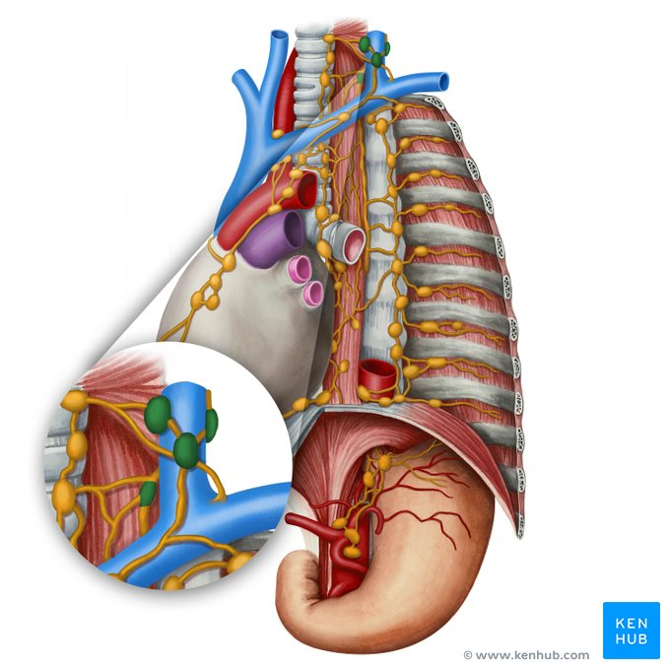
Lymphatics - Mediastinum
Key points about the lymphatics of the mediastinum
Main lymphatic vessels | Thoracic duct: Drains most of the mediastinal organs via left bronchomediastinal lymphatic trunk (as well as the majority of the body, except for regions received by right lymphatic duct listed below) Right lymphatic duct: Drains left side of the heart, right lung, lower lobe of left lung, right side of the thorax via right bronchomediastinal lymphatic trunk (as well as right side of the head and neck and right upper limb)
Main groups of lymph nodes | Brachiocephalic lymph nodes: Drain thymus, thyroid glands, pericardium and right side of heart → ipsilateral bronchomediastinal lymph trunk Posterior mediastinal lymph nodes: Drain esophagus, posterior pericardium, and posterior surface of the diaphragm → thoracic duct Paratracheal lymph nodes: Drain lungs, larynx, laryngopharynx, trachea, thyroid gland, and esophagus → ipsilateral bronchomediastinal lymph trunk Superior and inferior tracheobronchial lymph nodes: Drain bronchi and lungs (receives lymph from the intrapulmonary and bronchopulmonary nodes), left side of heart → paratracheal lymph nodes Intercostal lymph nodes: Drain posterolateral part of thoracic wall, parietal pleura and breasts as well as vertebral column and deep muscles of back Superior phrenic lymph nodes: Drain diaphragm, pericardium, diaphragmatic pleura, and lowest intercostal spaces

Slide 7
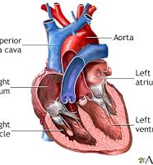
Basic anatomical elements of the heart
• Conical hollow muscular organ situated in the middle mediastinum and is enclosed within the pericardium
• compound (depressor) pump - sucks & pushes blood
• fist size of the person it belongs to
• weight about 300 g.
• relatively larger in size in men than in women
• 4 chambers (2 atrials - 2 ventricles)
• atrial & atrial septum
• 2 AV valves (tricuspid & bicuspid or mitral)
• 2 arterial valves (pulmonary & aortic)
• fibrous skeleton of the heart (in the form of fibrous rings around the orifices of the atrioventricular & arterial valves

Slide 8
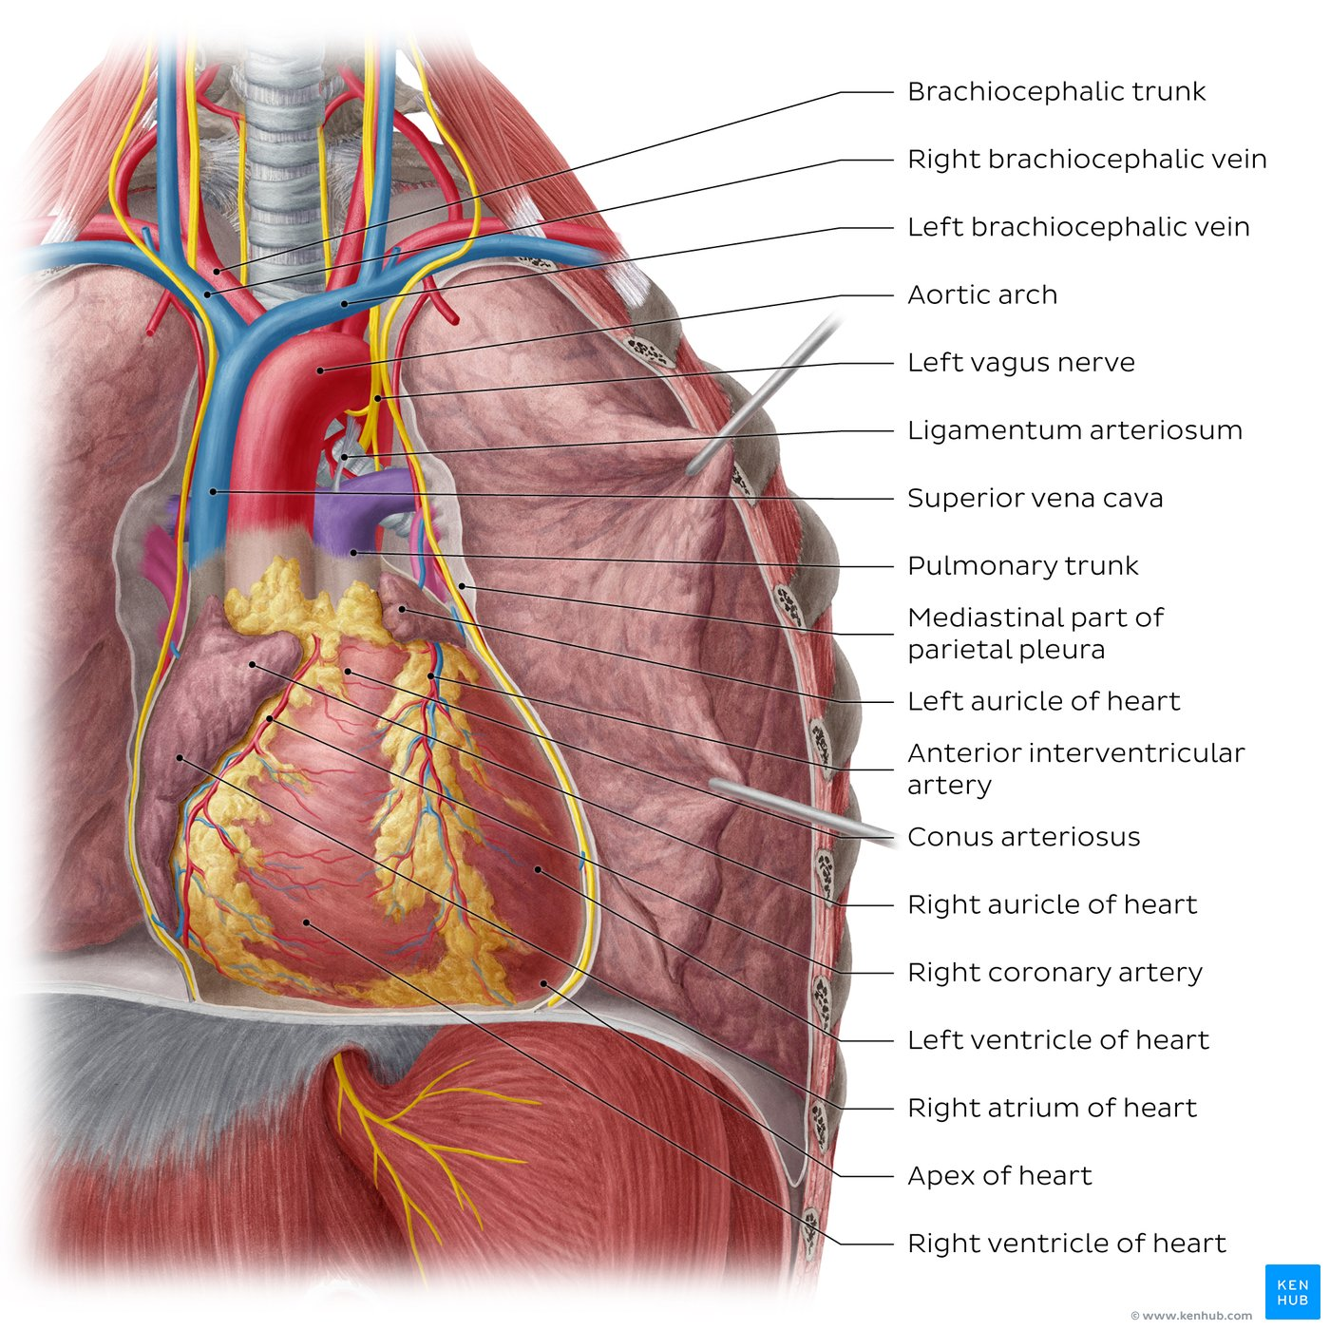
Structures of the heart
Chambers
Right atrium (blood enters heart through SVC and IVC)
Right ventricle (blood enters through the tricuspid valve or right atrioventricular valve, blood travels to the lungs via the pulmonary trunk)
Left ventricle (oxygenated blood gets pumped through the ascending aorta and the aortic arch to the body, 3 major branches: brachiocephalic trunk, left common carotid artery and left subclavian artery)
Left atrium (seen from the back)
Atrial Appendages (Auriculae): left and right auricle
External Features: Conus arteriosus (connects right ventricle to pulmonary trunk), anterior interventricular sulcus (runs branch of left coronary artery), apex of the heart (part of left ventricle)

Slide 9
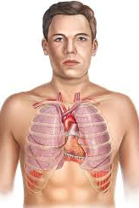
Projection of the heart on the chest wall
Anterior wall
irregular quadrilateral, trapezoidal shape
• Left borders
2nd costal cartilage to 5th intercostal space
1.5 and 8.5 cm from midline respectively.
• Right borders
3rd costal cartilage to 6th costal cartilage, 2.5 cm
from midline, the most convex 2.5 cm.

Slide 10
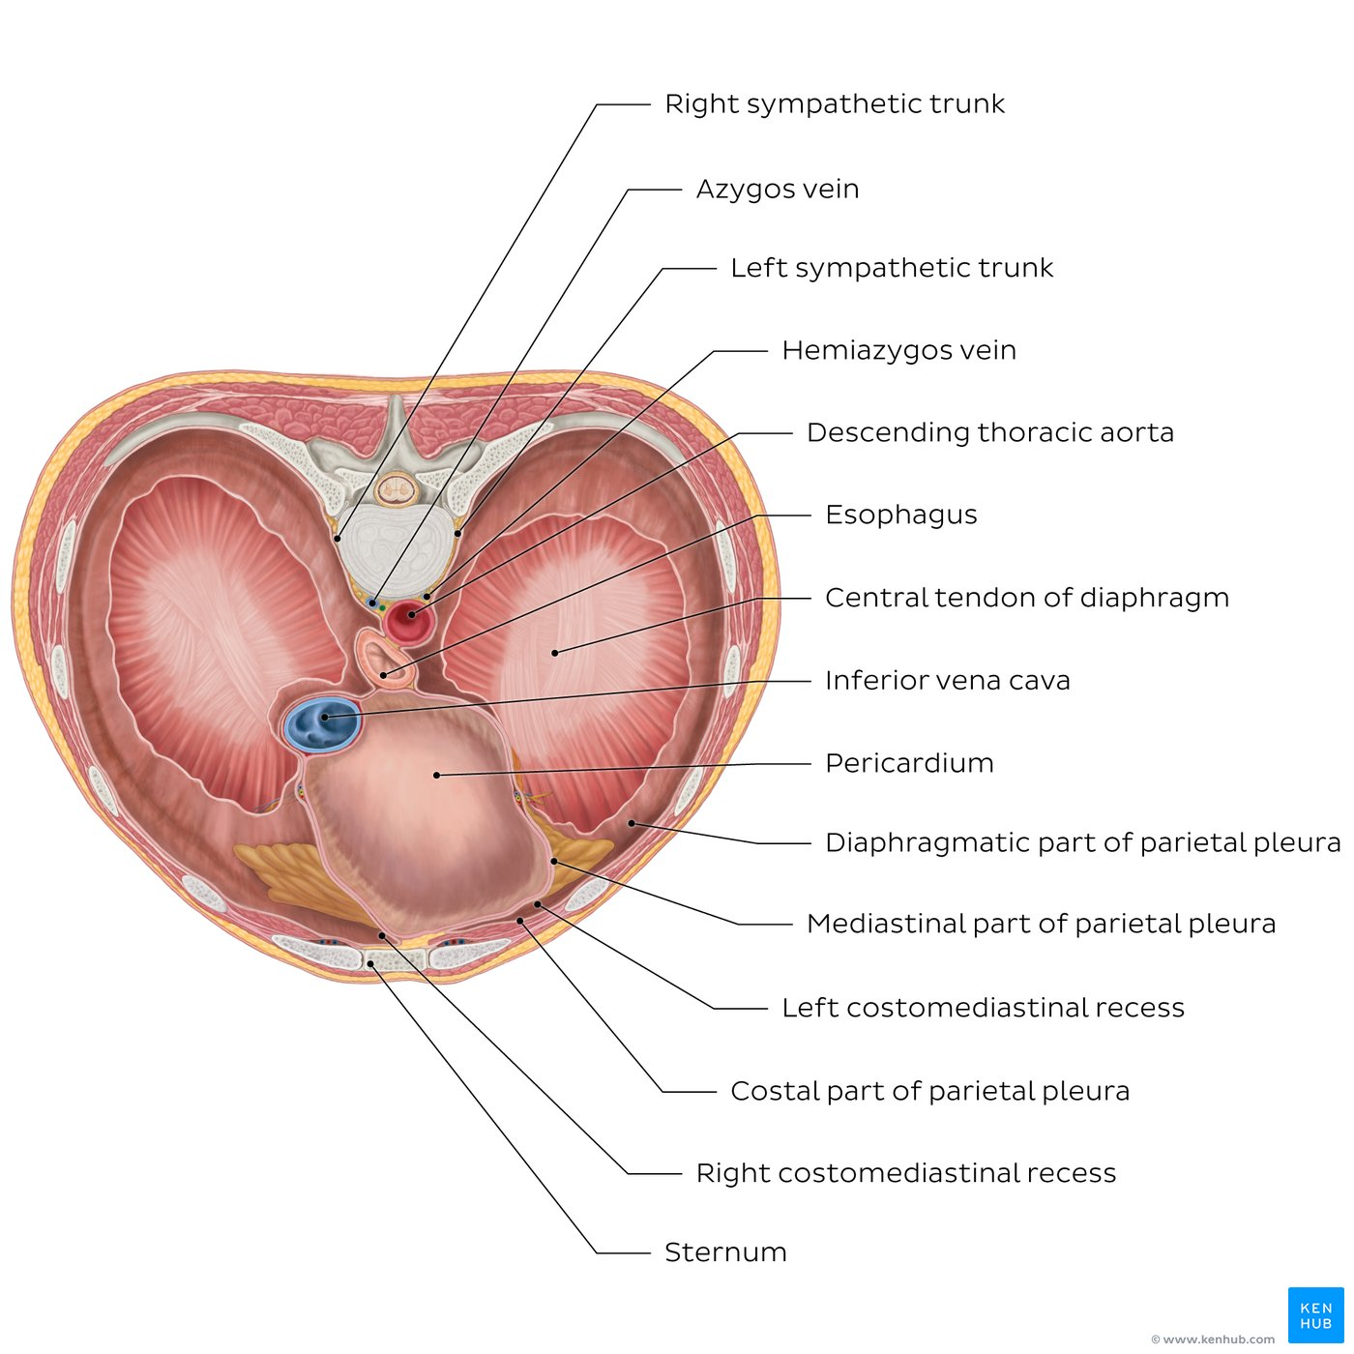
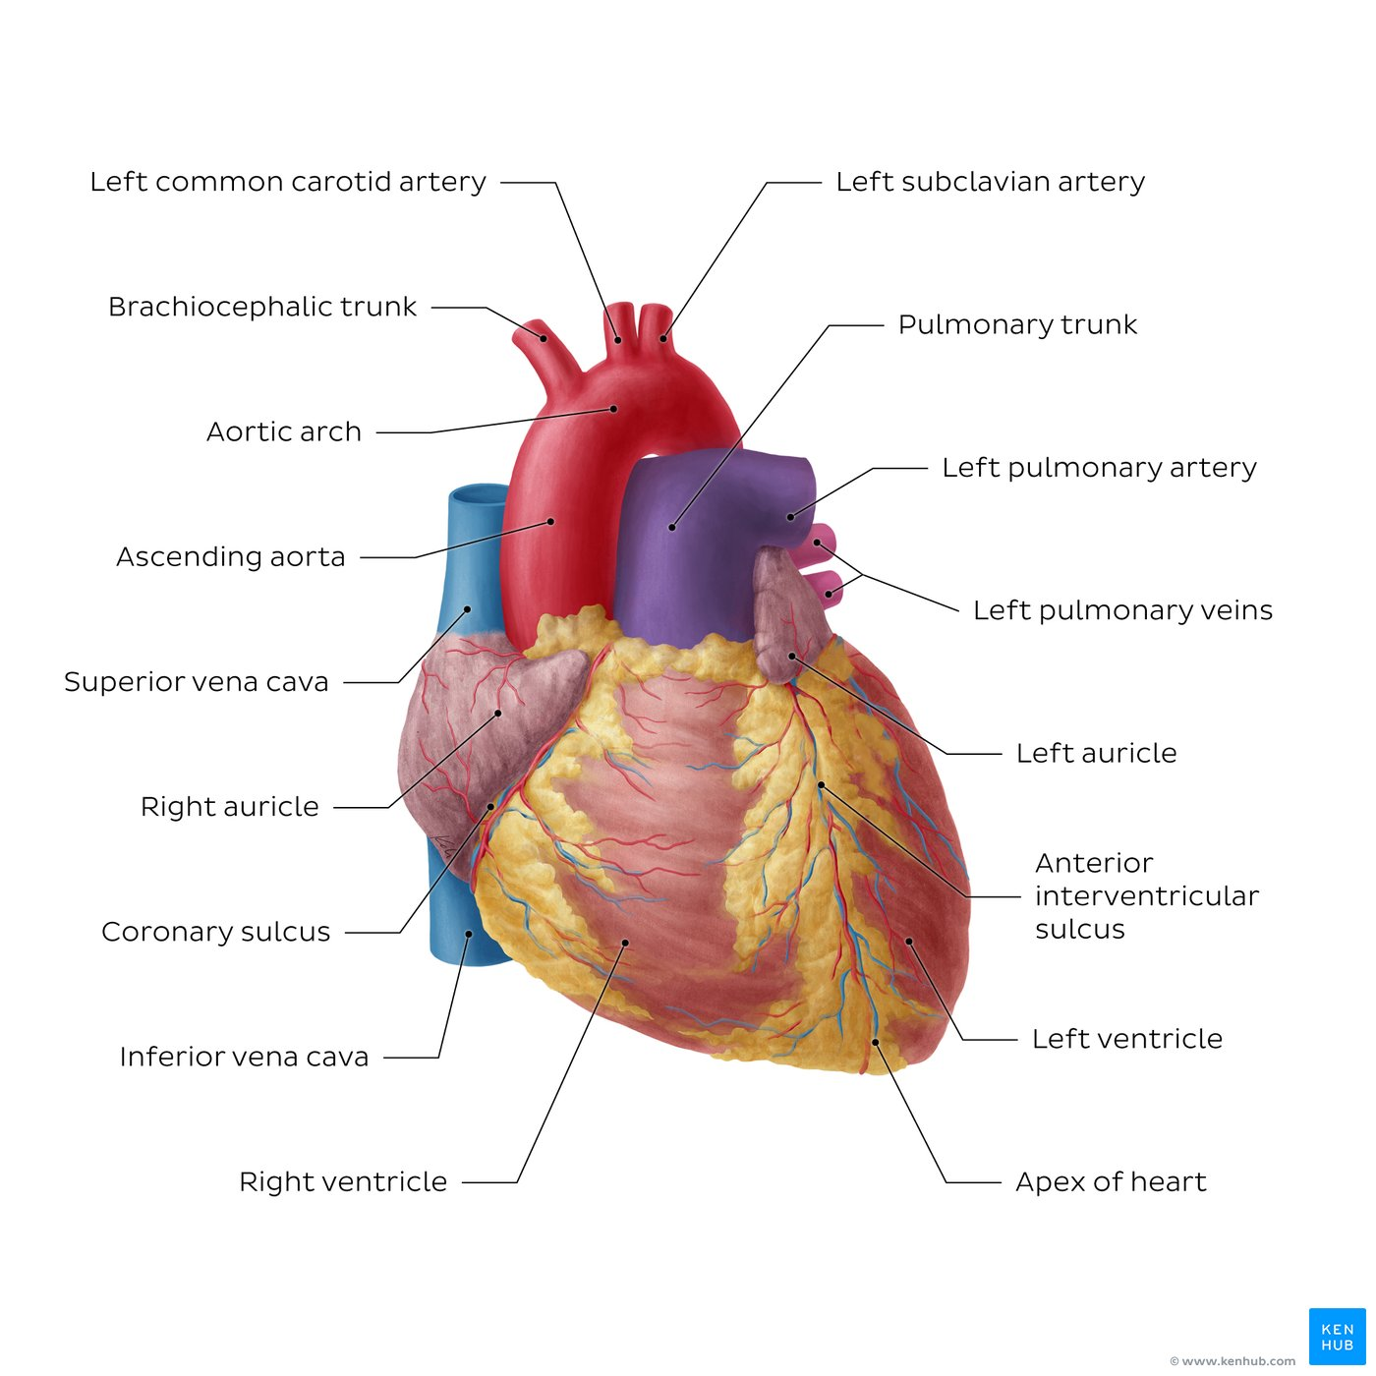
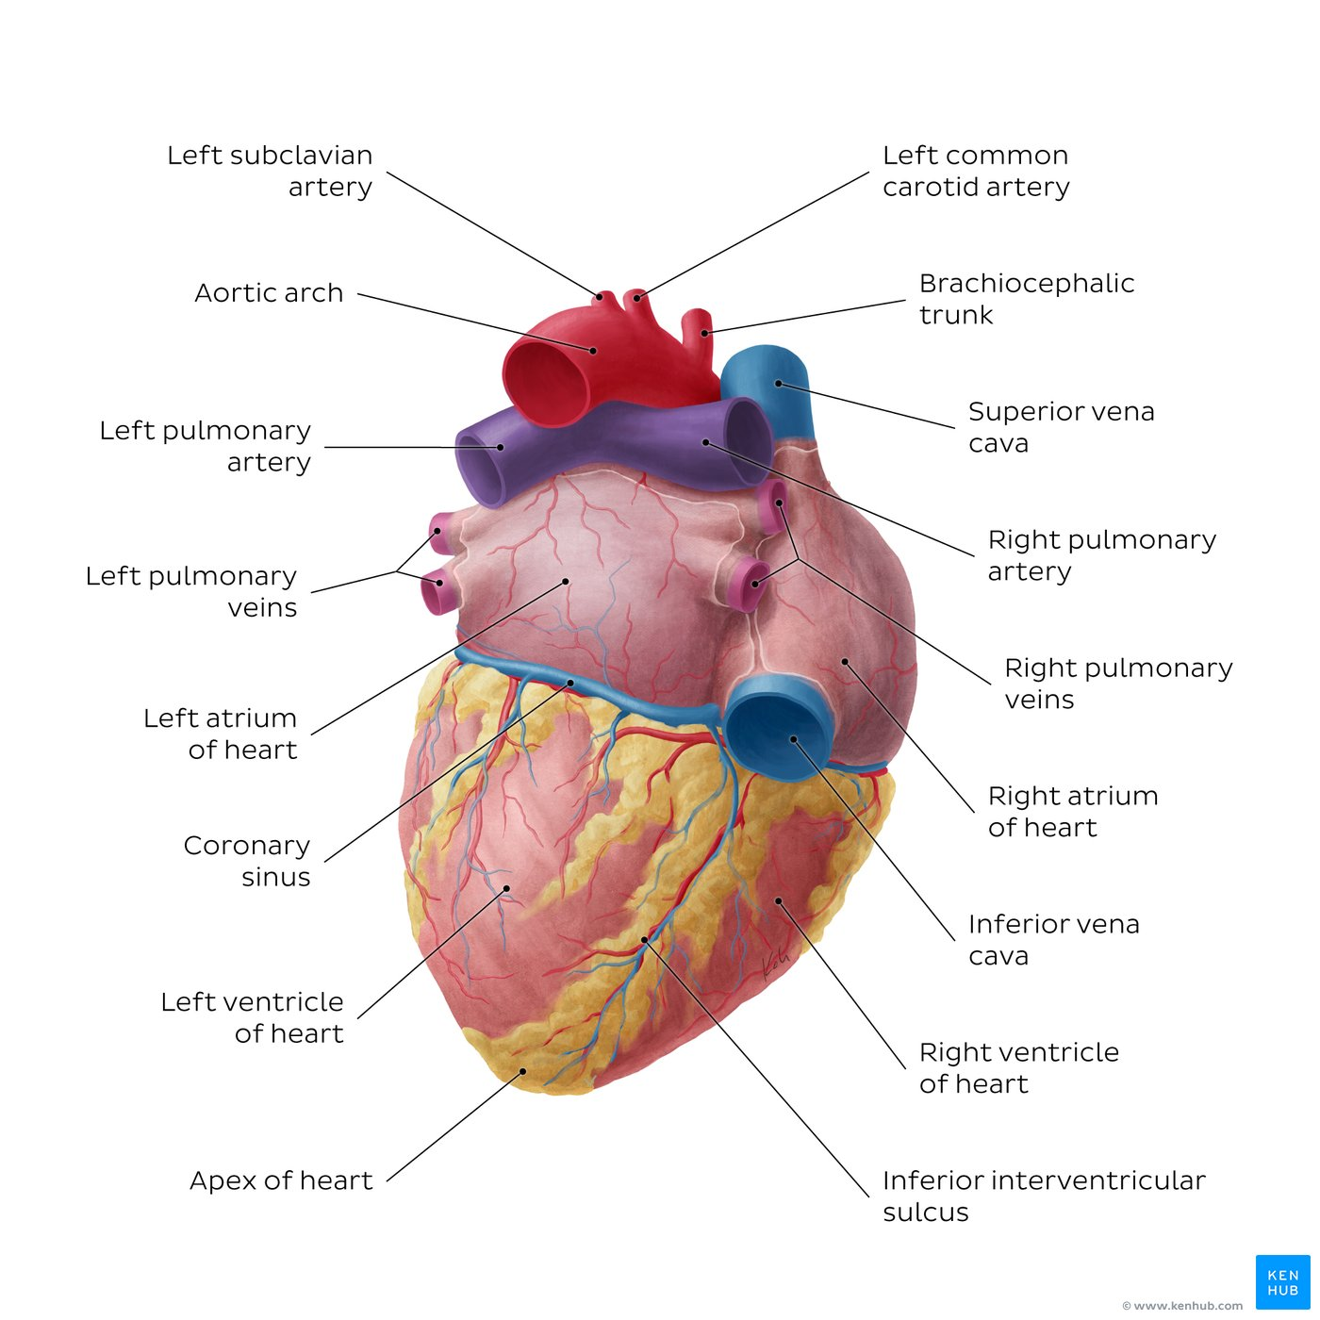
Position of the heart in summary
Behind the body of the sternum, the corresponding costal cartilages (3rd-6th) and the parts of the corresponding left ribs.
Location: Middle mediastinum, mostly to the left of the midsagittal plane Orientation: Positioned in a direction extending from the right shoulder to left hypochondrium, with the apex biased towards the left
Visceral relationships: Pericardium (sac surrounding the heart), Thymus (anterior), Lungs (lateral), Diaphragm (inferior), Esophagus (posterior)
Surrounding neurovasculature:
Arteries: Aortic arch, brachiocephalic trunk, right and left common carotid arteries, right and left subclavian arteries, internal thoracic artery, pericardiacophrenic artery, pulmonary trunk
Veins: Left and right internal jugular veins, left and right subclavian veins, left and right brachiocephalic veins, superior vena cava, pericardiacophrenic vein
Nerves: Left and right vagus nerves (CN X), left and right phrenic nerves

Slide 11
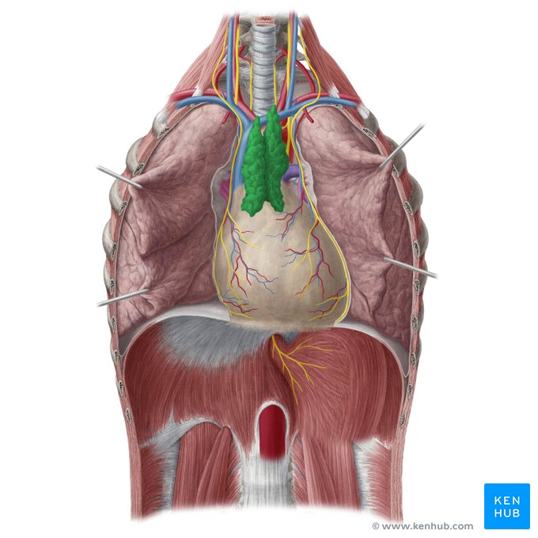
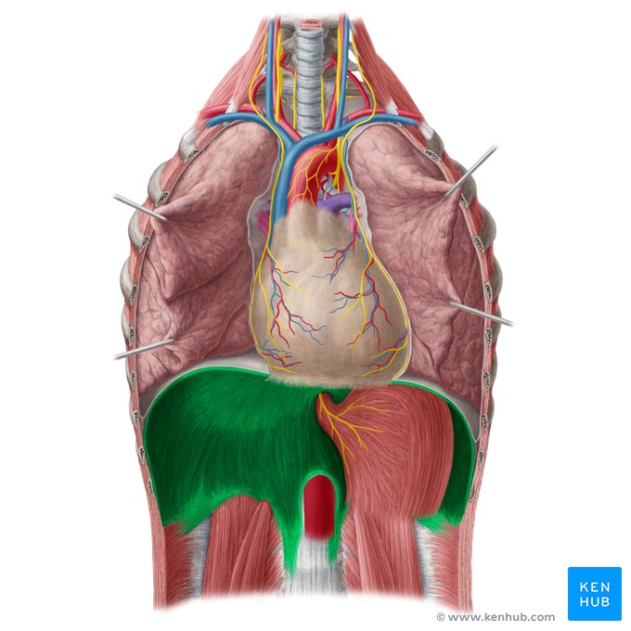
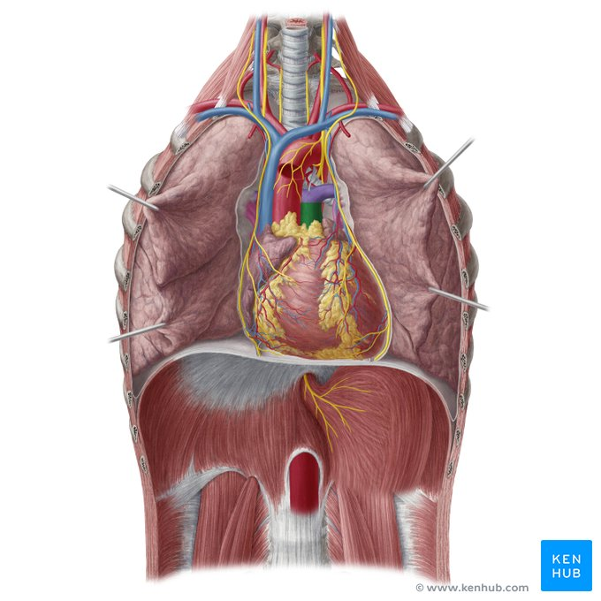

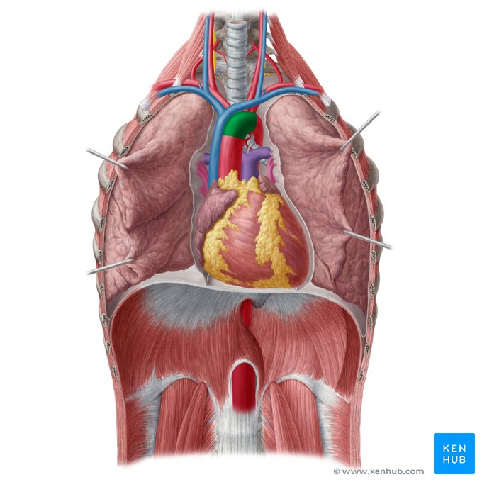
Heart in situ: thymus, diaphragm, pulmonary trunk, aortic arch, superior vena cava

Slide 12
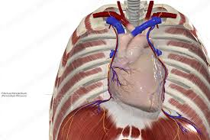
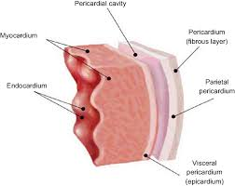
Pericardium
- This layer of tissue forms a sac around the heart and has 2 layers the fibrous pericardium (superficial) and the serous pericardium
-The serous pericardium is divided into two parts
The parietal layer of the serous pericardium (on the inner surface of the fibrous pericardium)
The visceral layer of the serous pericardium (adhered directly into the heart) or epicardium
Between the layers a small amount of pericardial fluid
The pericardium helps protect the heart from infections and while fixing it to the mediastinum. It provides lubrication as blood is pumped through the body.

Slide 13
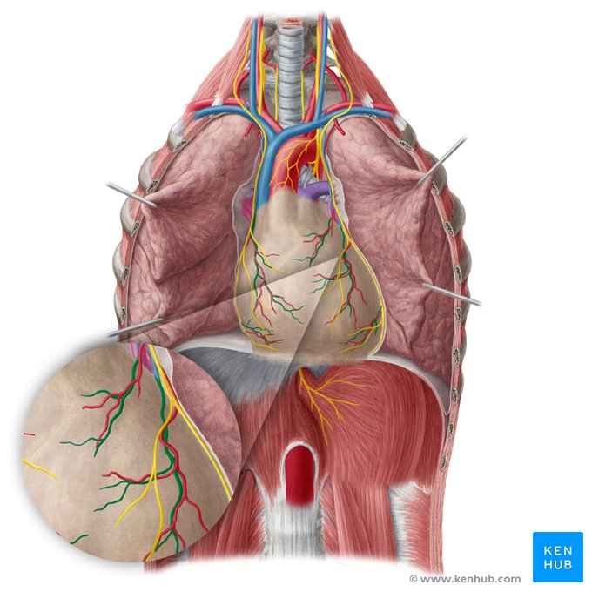
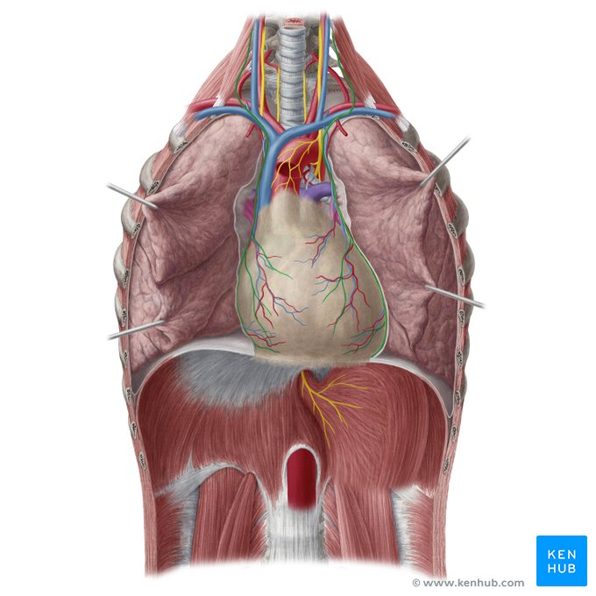
Arterial supply of the pericardium
It receives blood from the pericardiophrenic vessels -- branches of the internal mammary artery
sensory innervated by the phrenic nerve -- reflex pain in the ipsilateral supraclavicular region

Slide 14
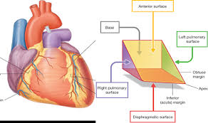
Surfaces & margins of the heart
Three-sided pyramid. Base: the two atrium. Apex: the two ventricles
It presents five surfaces:
Anterior (sternocostal) surface: lies adjacent to the body of sternum, transversus thoracis muscle and the third to sixth costal cartilages, lies posterior to the anterior mediastinum.
Inferior (diaphragmatic) surface: sits mainly on the central tendon of the diaphragm.
Left and right (pulmonary) surfaces: face the left and right lungs, respectively. The left surface involves the lateral portion of the left ventricle as well as a small part of the left atrium/auricle, while the right surface is found between the superior vena cava and the intrathoracic part of the inferior vena cava.
Posterior surface (base): lies anterior to the principal bronchi and esophagus.
The heart also presents four borders:
The right border is a line that runs mainly over the right atrium, extending between the superior and inferior vena cava, and over a small portion of the right ventricle.
The left (obtuse) border separates the left and anterior surfaces, mainly formed by the left ventricle and part of the left auricle.
The superior border is a line that goes over the roots of the aorta and pulmonary trunk and a small portion of the left and right auricle.
The inferior (acute) border extends along the right ventricle and part of the left ventricle at its apex.

Slide 15
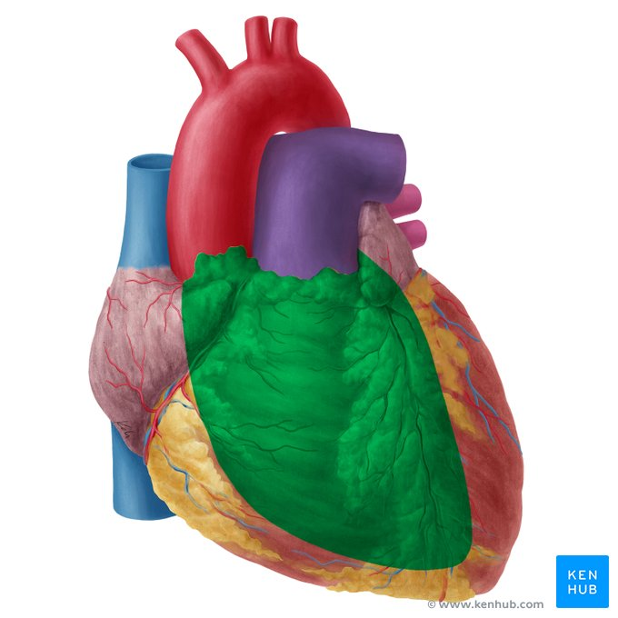
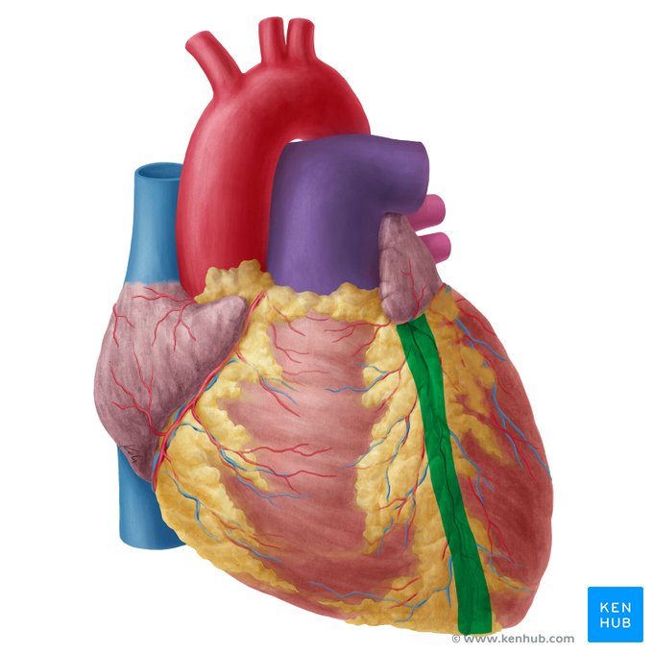
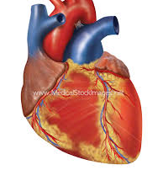
External morphology of the heart Sternocostal surface (anterior aspect)
This surface is formed mainly by the right atrium and the right ventricle
• Divided by the coronary (atrioventricular) groove into :
- Atrial part, formed mainly by right atrium.
- Ventricular part , the right 2/3 is formed by right ventricle
• The 2 ventricles are separated by the anterior interventricular groove, which lodges :
- Anterior interventricular artery (branch of left coronary).
- Great cardiac vein.
The coronary groove lodges : the right coronary artery (located just below the right atrium and just above the right ventricle).

Slide 16
External morphology of the Heart Diaphragmatic surface
Formed by the 2 ventricles, mainly left ventricle (left 2/3).
Slightly concave as it rests on diaphragm.
Directed inferiorly & backward.
Separated from the base of the heart by the posterior part of the coronary sulcus.
The 2 ventricles are separated by the posterior interventricular groove which lodges:
• Posterior interventricular artery
• Middle cardiac vein

Slide 17
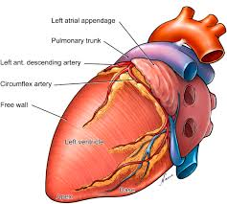
Lateral surface of the heart
It is formed by the lateral wall of the left ventricle
Electrocardiographically it is studied in leads V5, V6, I and aVL
It is mostly supplied by branches of the Circumflex artery.

Slide 18
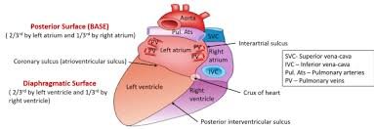
External morphology (posteroinferior aspect) of the heart
The inferior surface is mostly made up of the left ventricle and part of the right ventricle and gently slopes anteroinferiorly from the base of the heart towards the apex. It is separated from the anatomical base (posterior surface) of the heart by the posterior part of the coronary sulcus.
The posterior surface is largely formed by the left atrium which is pierced by four pulmonary veins, as well a small portion of the right atrium which receives the superior and inferior venae cavae. The atria are separated by a shallow interatrial sulcus, which together with the coronary and inferior interventricular sulci, form the crux of the heart.
Atrioventricular groove:
atrial / ventricular border - Atrioventricular level valves - Course of coronary vessels – coronary sinus
Posterior inteventricular groove : Border RV / LV
- Course of Posterior descending artery (PDA) and the middle cardiac vein

Slide 19
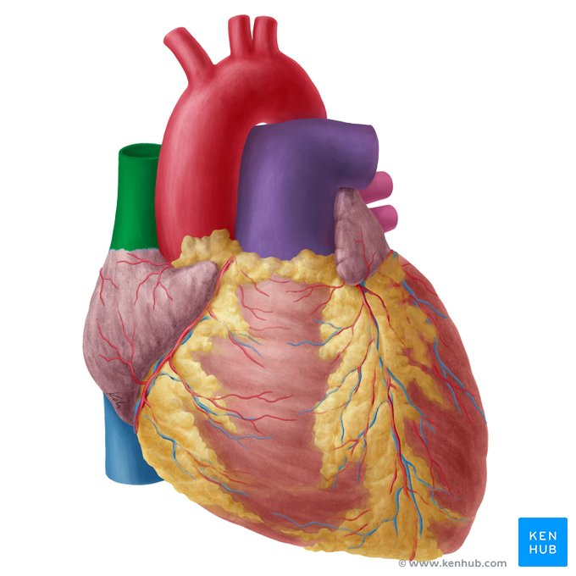
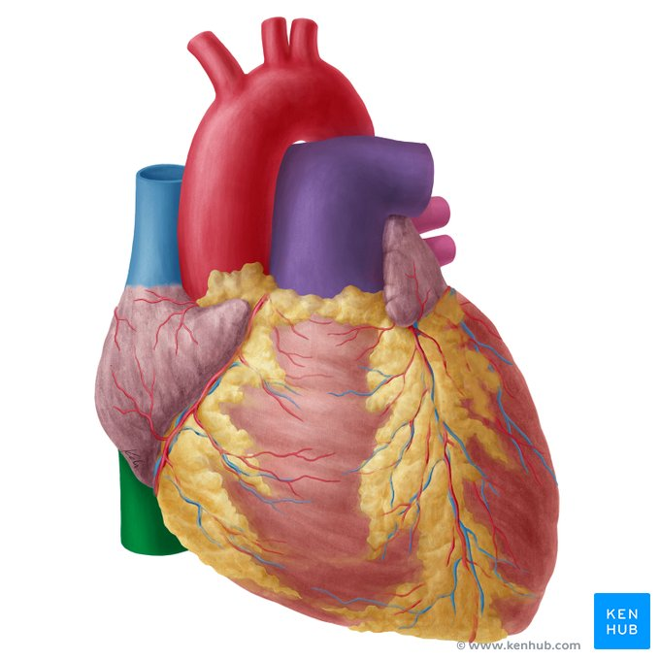
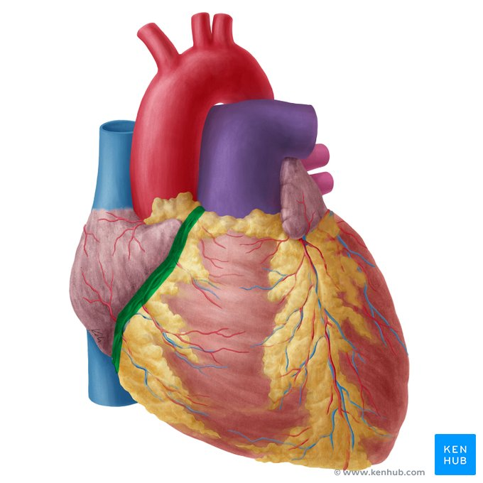
Superior wall
• SVC (superior vena cava)--- has no valve
Inferior wall
IVC (inferior vena cava)--- guarded by a valve
Coronary sinus : has a well defined valve
Right atrioventricular orifice lies anterior to IVC opening , it is surrounded by a fibrous ring which gives attachment to the tricuspid valve
Small orifices of small veins

Slide 20
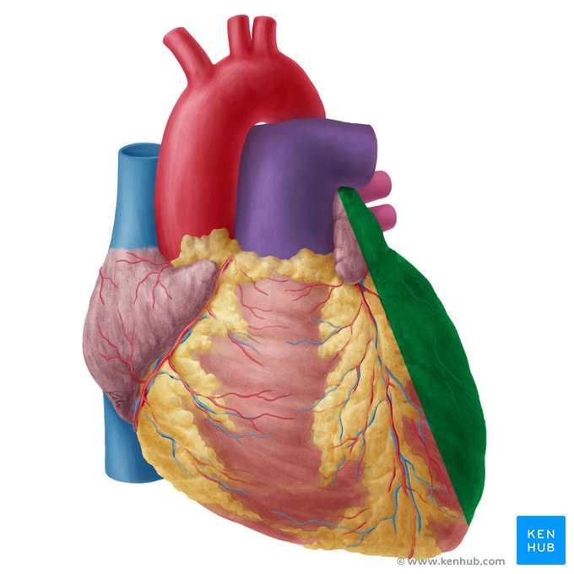
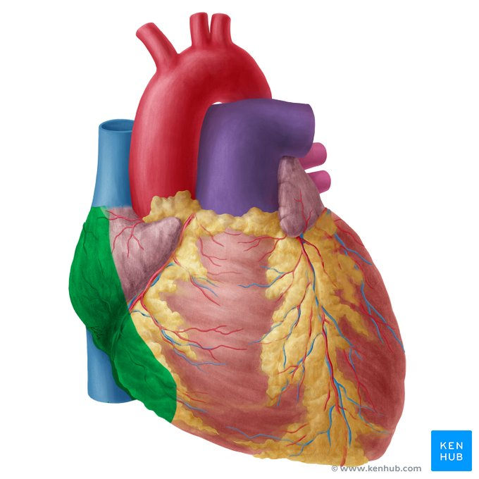
Left & right surface of the heart
Left surface
It is formed mainly by the left ventricle, in relation to the fossa of the left lung
Right surface
It is formed mainly of the right surface of the right atrium. It lies anterior to the hilus of the right lung and it is separated from the cardiac impression on its mediastinal surface by the layers of pericardium and pleura.

Slide 21
Key points about the surfaces of the heart
Anterior (sternocostal) surface | Components: Right atrium, ⅔ right ventricle, ⅓ left ventricle Landmarks: Right auricle of heart, coronary sulcus, anterior interventricular sulcus, cardiac apex Vessels: Right coronary artery, anterior interventricular artery/vein, anterior veins of right ventricle Relations: Sternum, sternocostal muscles, third to sixth costal cartilages
Inferior (diaphragmatic) surface | Components: Left ventricle, right ventricle Landmarks: Inferior (posterior) interventricular groove, atrioventricular groove, cardiac apex Vessels: Inferior (posterior) interventricular artery, middle cardiac vein, coronary sinus, inferior vein of left ventricle Relations: Sits mainly the central tendon of diaphragm, and a small portion of left muscular part of diaphragm
Left (pulmonary) surface | Components: Left ventricle, small part of left atrium and left auricle of heart Landmarks: Atrioventricular groove Vessels: Circumflex artery, great cardiac vein, left marginal vein Relations: Left pericardiacophrenic neurovascular bundle, left pleura/lung
Right (pulmonary) surface | Components: Right atrium Landmarks: Sulcus terminalis Relations: Intrathoracic part of inferior vena cava, superior vena cava, right pleura/lung
Posterior surface (base) | Components: Right atrium, left atrium Vessels: Coronary sinus, left and right pulmonary veins, vena cavae Relations: Principal bronchi, esophagus

Slide 22
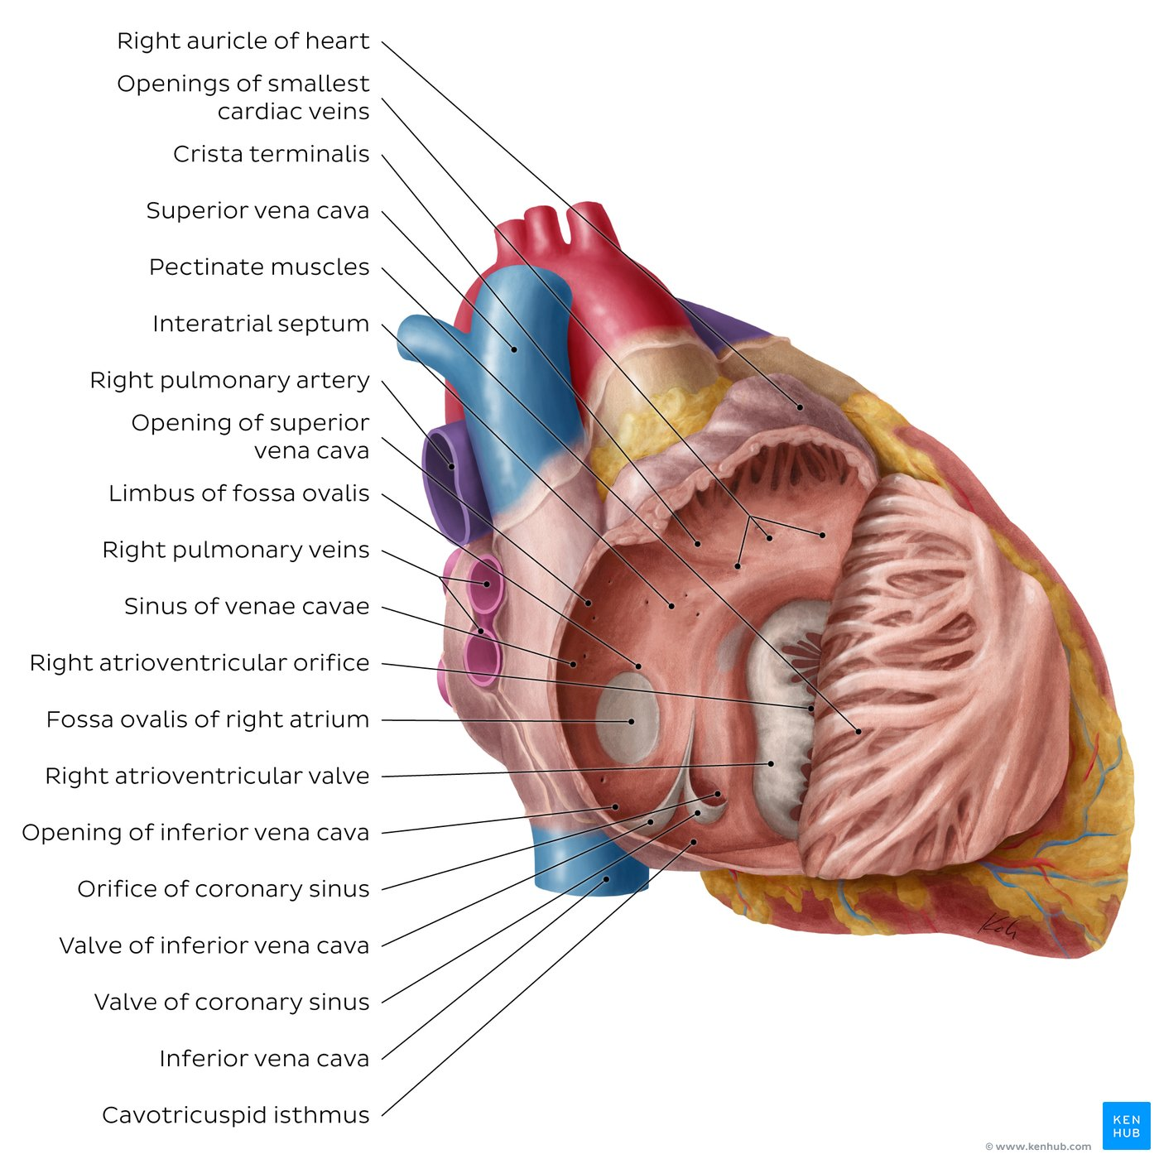
Right cardiac cavities - Morphology of right atrium
Consists of a main cavity and a small outpouching, the auricle.
● On the outside of the heart at the junction between the right atrium and the right auricle is a vertical groove, the sulcus terminalis, which on the inside forms a ridge, the crista terminalis.
➢ Crista terminalis divides right atrium into:
1. Anterior part: rough and trabeculated by bundles of muscle fibres (musculi pectinati).
2. Posterior part (sinus venarum) is smooth.
● The interatrial septum carries an oval depression called ASD Fossa ovalis. The margin of this depression is called Annulus ovalis.
It is the first chamber of the heart to receive the deoxygenated blood from the body via 3 main sources:
the superior vena cava (which drains blood from the upper parts of the body)
the inferior vena cava (which collects blood from the lower parts)
the coronary sinus (which drains blood from the heart itself
The blood leaves right atrium to right ventricle via the tricuspid valve.
One of the main features of the right atrium is the sinoatrial (SA) node that is placed within the wall of this chamber adjacent to the entrance of the superior vena cava. It is known as “the human pacemaker” that spontaneously generates electrical impulses and determines the normal heart rhythm.
Atrioventricular (AV) node: Part of electrical conduction system found near coronary sinus on the interatrial septum

Slide 23
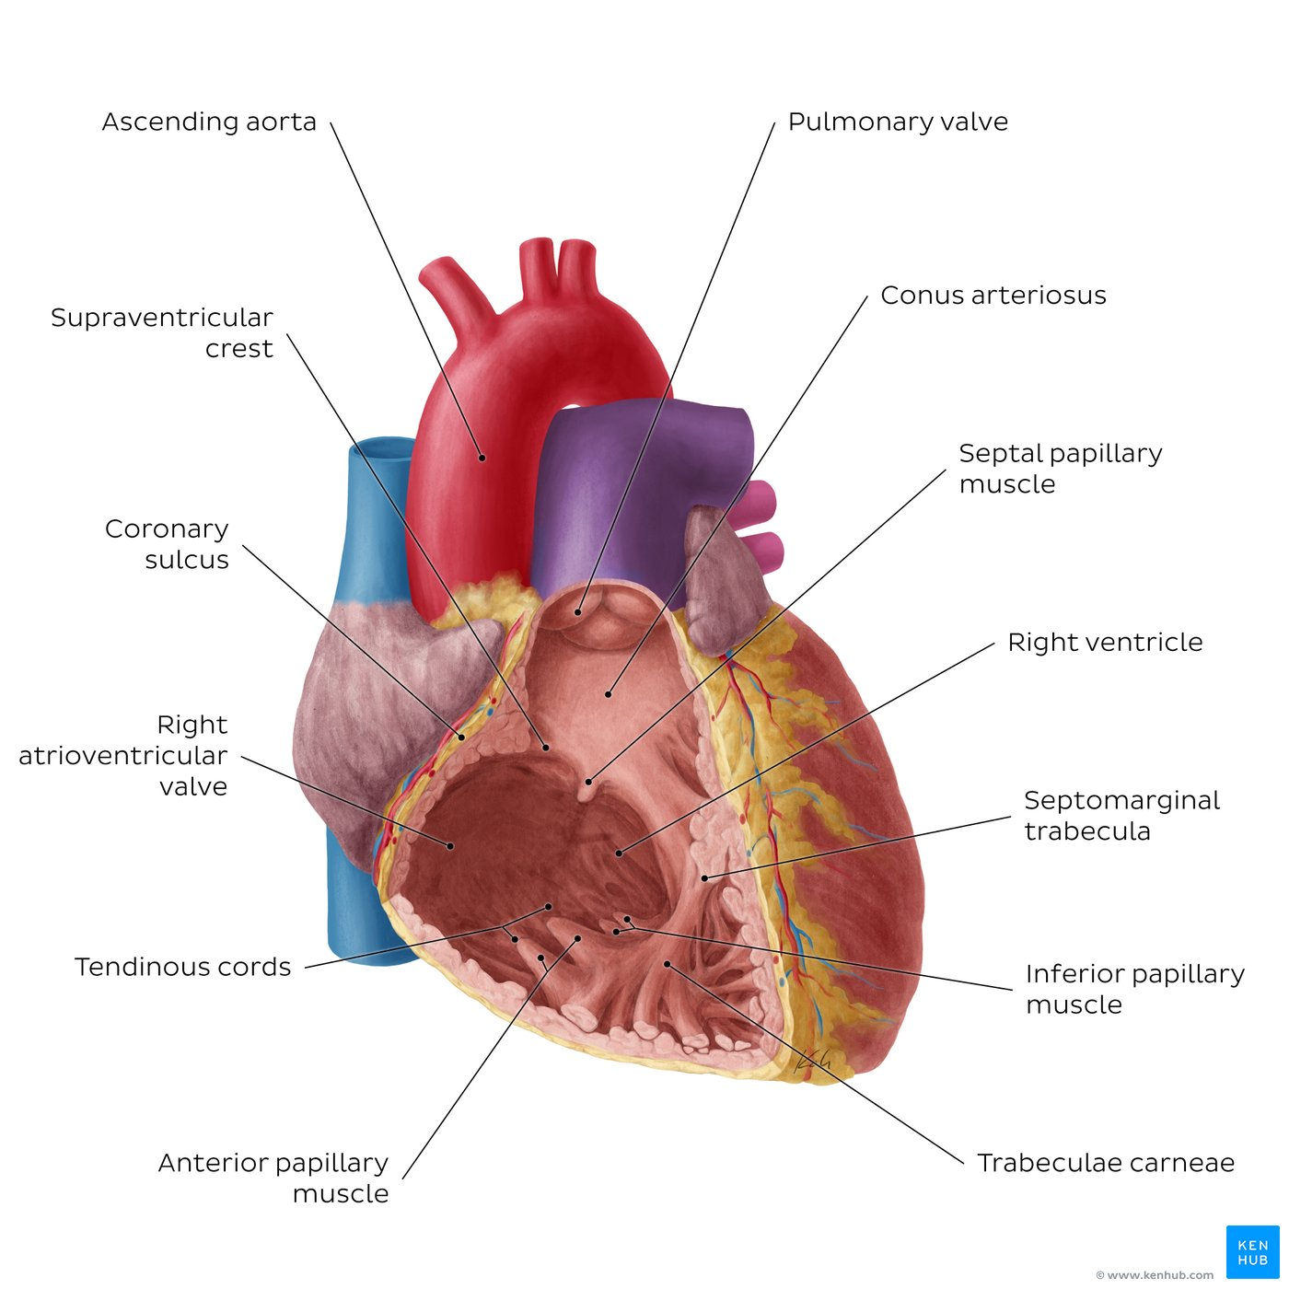
Right cardiac cavities - Morphology of right ventricle
● Its wall is thinner than that of left ventricle
● Its wall contains projections called trabeculae carnae.
● The right ventricle communicates with the right atrium through
1. The right atrioventricular orifice
2. The pulmonary trunk through pulmonary orifice
● As the cavity approaches the pulmonary orifice it becomes funnel shaped, at which point it is referred to as the infundibulum.
● The wall of the infundibulum (conus arteriosus) is smooth and contains no trabeculae.
● Blood leaves the right ventricle to pulmonary trunk through the pulmonary orifice
The right ventricle takes up the majority of the anterior surface of the heart. It receives blood from the right atrium and pumps it via the pulmonary trunk into the lungs for blood oxygenation. The blood flow between these heart chambers is regulated by the right atrioventricular (tricuspid) valve, allowing only unidirectional flow from the right atrium to the right ventricle. Similarly, the pulmonary valve permits the blood to flow from the right ventricle to the pulmonary trunk without regurgitation.
The structure of the pulmonary valve is illustrated immediately superior to the conus arteriosus.
The structure of the right atrioventricular (tricuspid) valve with its three papillary muscles (anterior, inferior (a.k.a.posterior) and septal) and their tendinous cords (chordae tendineae) can be seen in the previous illustration.

Slide 24
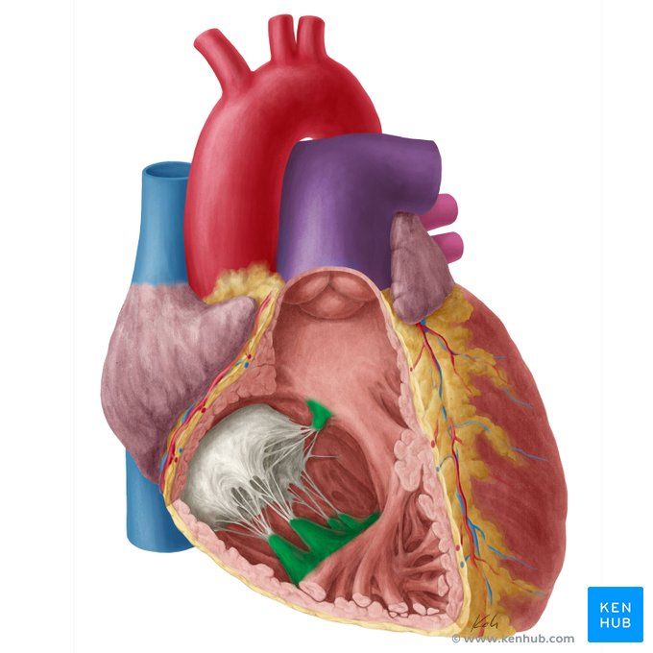
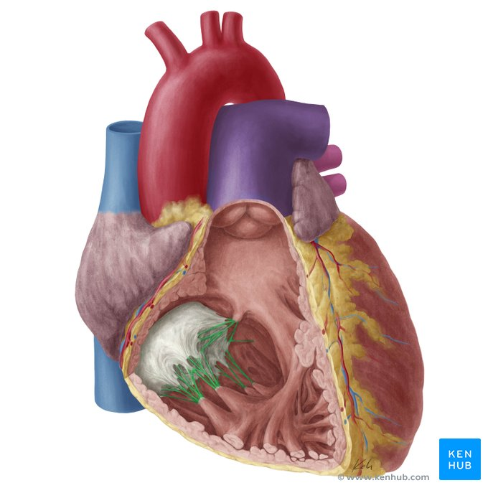
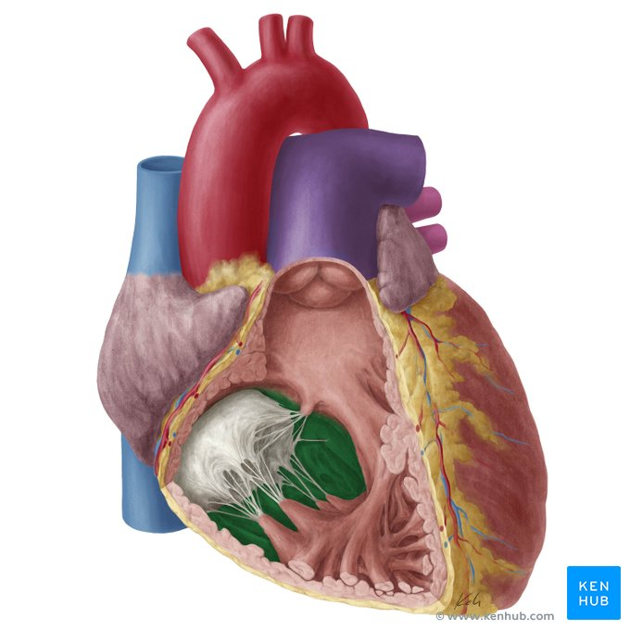
Large projections arise from the walls called papillary muscles :
1. Anterior papillary muscle
2. Posterior papillary muscle
3. Septal papillary muscle
● Each papillary muscle is attached to the cusps of tricuspid valve by tendinous threads called chordae tendineae.
● The Interventricular septum is connected to anterior papillary muscle by a muscular band called moderator band.

Slide 25
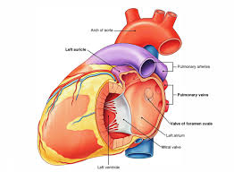
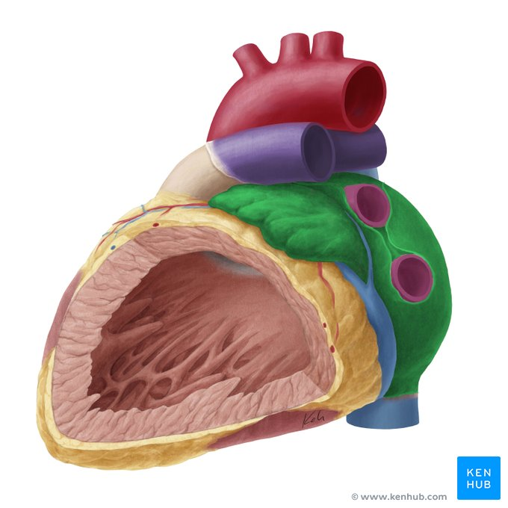
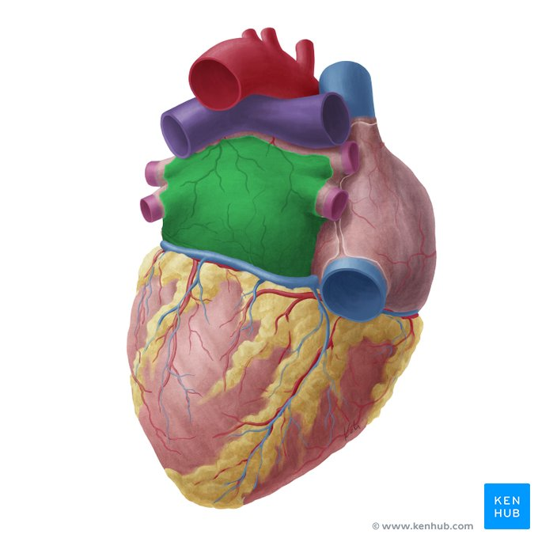
Left atrium of the heart
The left atrium occupies the base (posterior part) of the heart. It receives oxygenated blood from the lungs via four pulmonary veins (no valves) and pumps it into the left ventricle via the left atrioventricular orifice.
This orifice features the left atrioventricular (mitral/bicuspid) valve which functions to seal the atrioventricular opening during the ventricular contraction (systole). This prevents regurgitation of blood into the left atrium and redirects blood flow through the aortic orifice during ventricular systole.

Slide 26
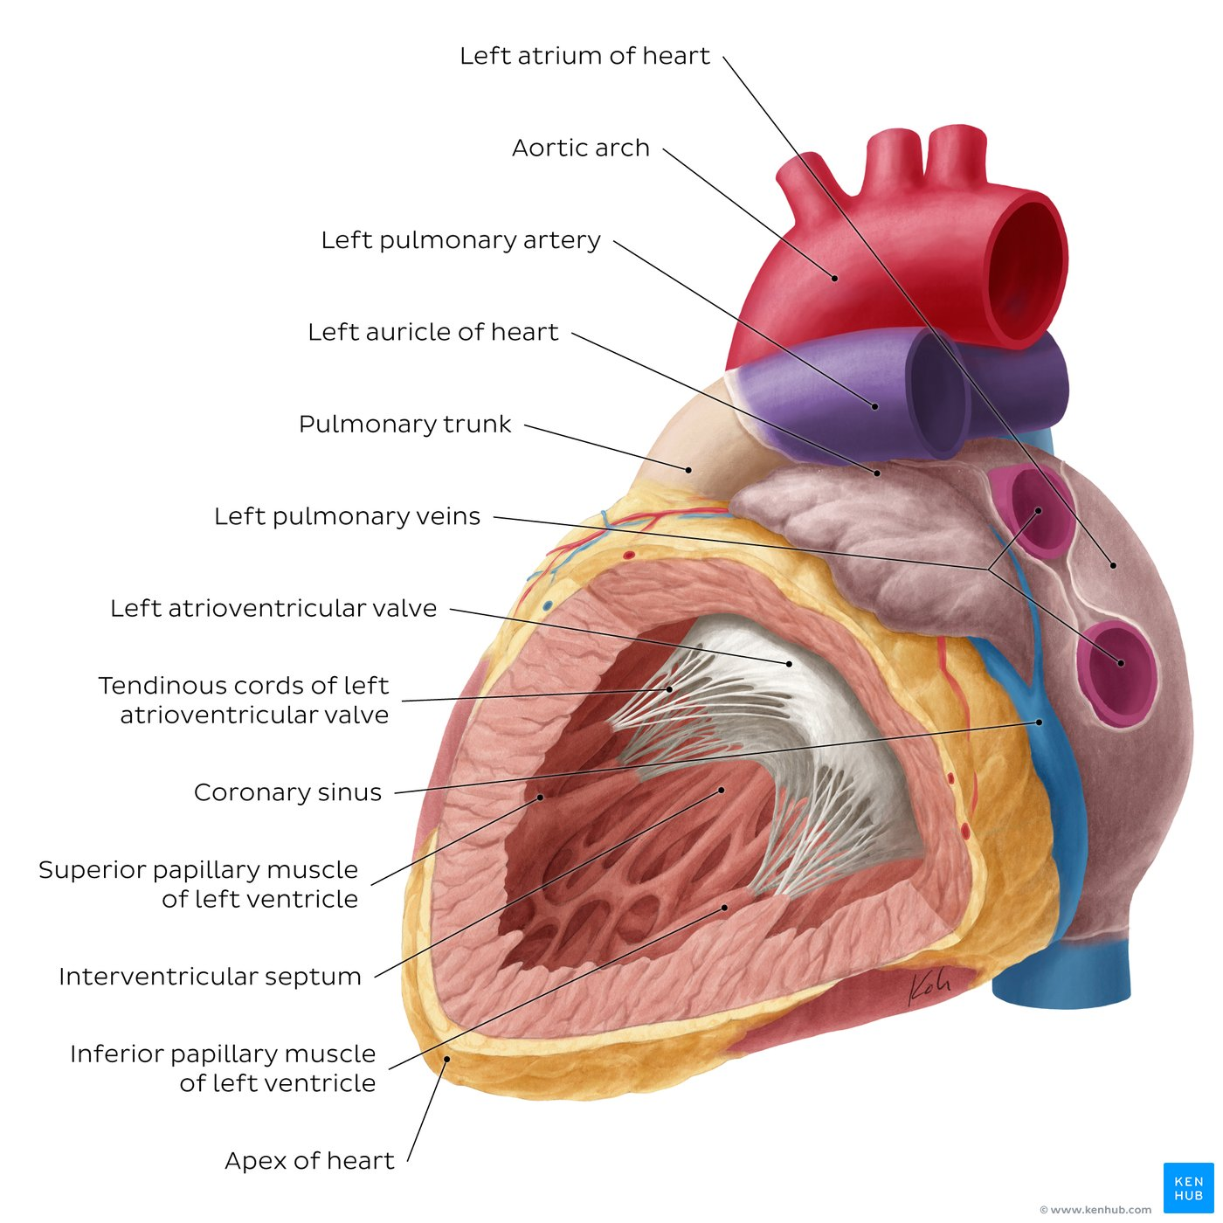
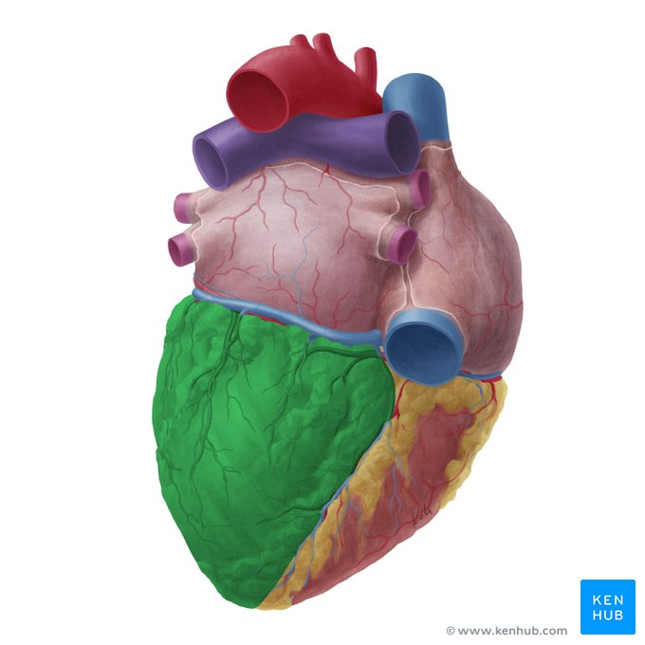
Left ventricle of the heart
It receives oxygenated blood from left atrium through the left atrio- ventricular orifice which is guarded by the mitral valve (bicuspid)
Its wall is thicker than that of the right ventricle and contains trabeculae carnae. Italong with 2 large papillary muscles (anterior & posterior) They are attached by chordae tendinae to the cusps of the mitral valve.
The part of left ventricle leading to ascending aorta is called aortic vestibule. The wall of this part is fibrous and smooth.
The blood leaves the left ventricle to the ascending aorta through the aortic orifice into systemic circulation.
Apex of heart: Rounded anteroinferior extremity of heart formed by left ventricle. Located at left 5th intercostal space approximately 9 cm from median plane where apex beat (sounds of left AV valve closure) is maximal

Slide 27
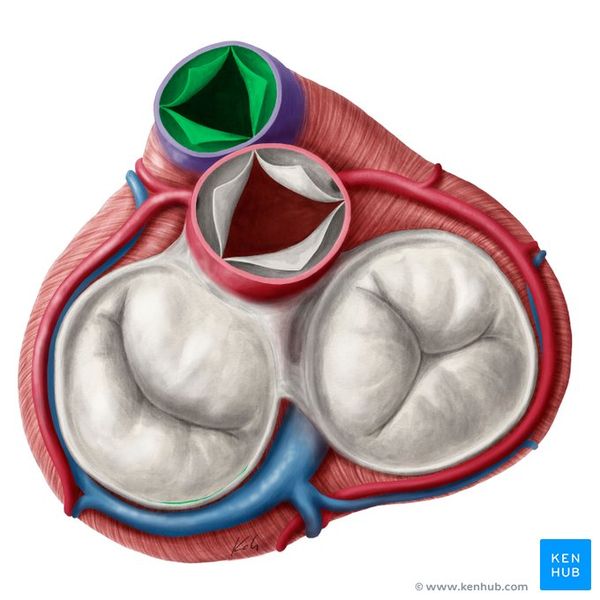
Heart valves
There are four valves in the heart which can be divided into two groups, the atrioventricular valves and semilunar valves. The atrioventricular valves are located between the atria and ventricles.
The right atrioventricular valve (tricuspid valve) is positioned between the right atrium and the right ventricle
The left atrioventricular valve (mitral or bicuspid valve) lies between the left atrium and the left ventricle.
The semilunar valves are the pulmonary valve, located between the right ventricle and the pulmonary trunk, and the aortic valve, between the left ventricle and aorta.
All the valves comprise a fibrous core covered by endocardial lining facing the chambers of the heart, and they promote unidirectional flow of blood through the heart. The pulmonary valve is illustrated.

Slide 28
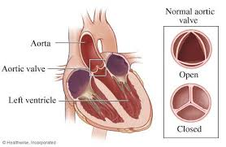
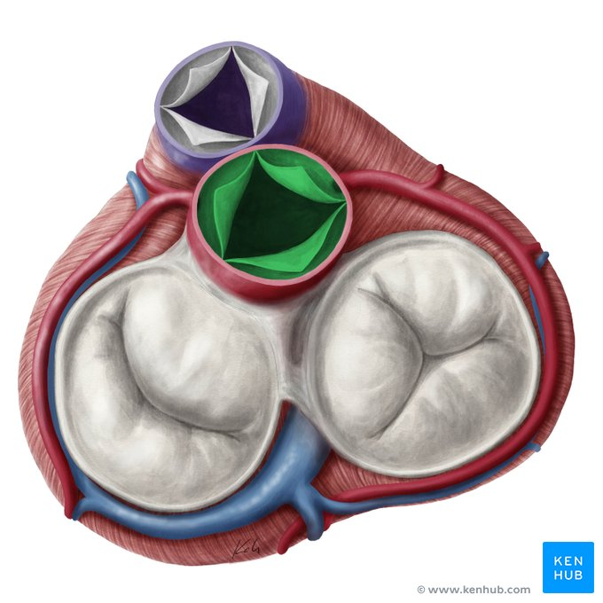
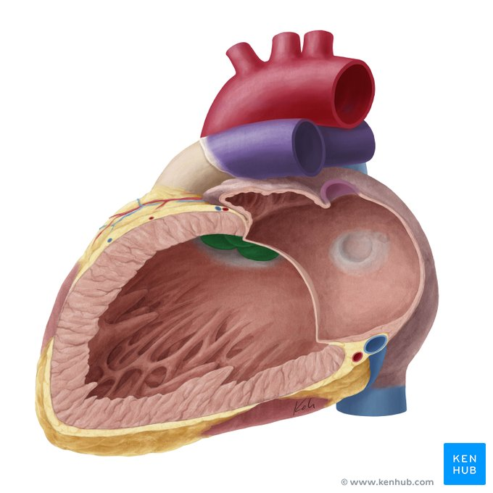
Aortic valve
• Normal tricuspid aortic valve (TAV) consists of three semilunar, swallow nest cusps,
• 3 commissures (the highest part of the attachment of the cusps at the aortic sino-tubular junction) and
• 3 interleaflet triangles

Slide 29
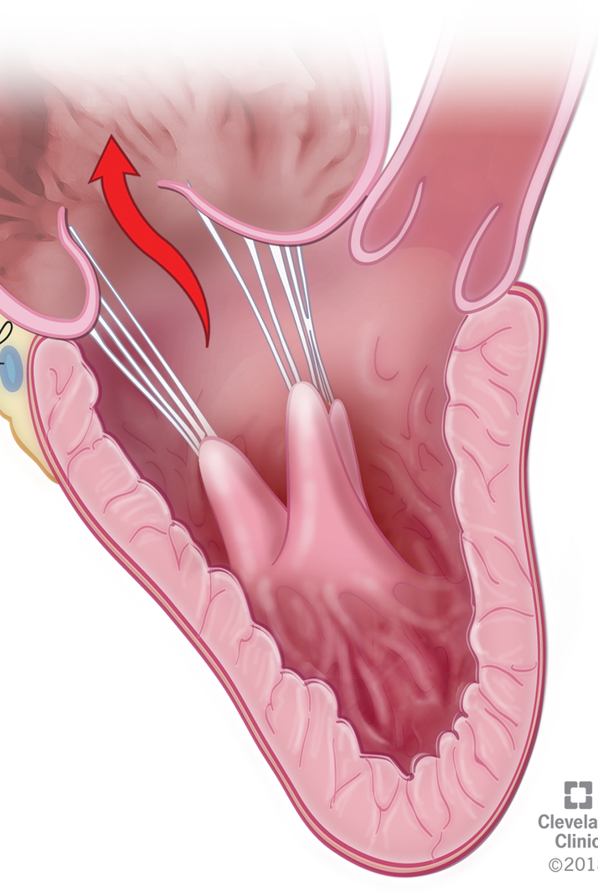
Mitral Valve
Tendinous cords:
- primary
- secondary
Tertiary
Papillary musucles:
- Anterior - External
- Posterior - Internal
Blood supply of the papillary mucles:
- Anterior (LAD + marginal branches of LCx)
- Posterior (PDA)

Slide 30
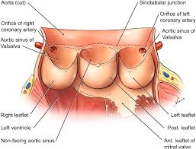
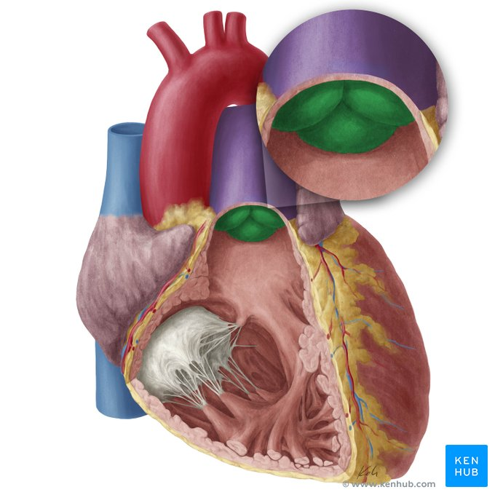
Aortic – Pulmonary valve leaflets and Valsalva sinuses
• Swallow's nest shape
• Nodule (Arantius)
• Lunula
• Aortic sinuses (Valsalva )

Slide 31
Key points about the heart valves
Right atrioventricular valve (tricuspid) | Leaflets (cusps): 3 - superior (anterior), inferior (posterior) and septal Papillary muscles: Anterior, septal (medial) and inferior (posterior) Position: Between right atrium and right ventricle Function: Prevents backflow from right ventricle into right atrium
Left atrioventricular valve (mitral) | Leaflets (cusps): 2 - anterior (aortic) and posterior (mural) Papillary muscles: Inferior (posterior) and superior (anterolateral) Position: Between left atrium and left ventricle Function: Prevents backflow from left ventricle into left atrium
Pulmonary valve | Leaflets (cusps): 3 - anterior (non-adjacent), right (right adjacent), and left (left adjacent) (No associated papillary muscles) Position: Between right ventricle and root of pulmonary trunk Function: Prevents backflow from pulmonary circulation into right ventricle
Aortic valve | Leaflets (cusps): 3 - right coronary (right semilunar), left coronary (left semilunar), and non-coronary (posterior semilunar)(No associated papillary muscles) Position: Between left ventricle and root of aorta Function: Prevents backflow from systemic circulation into left ventricle

Slide 32
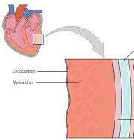
Myocardium
Functional syncytium of muscle fibers
Loose connective tissue
Blood vessels
Nerve endings
Its muscle fibers form 2 layers:
A) the superficial layer, and
B) the deep layer

Slide 33


Coronary arteries and cardiac veins
They comprise the coronary circulation that is responsible for the blood supply and drainage of the heart muscle (myocardium).
The two main coronary arteries are the left and right coronary arteries.
The left coronary artery is usually of a larger caliber and typically gives off two main branches that supply most of the left atrium, the left ventricle and the interventricular septum.
The smaller, right coronary artery supplies the right atrium, right ventricle, interatrial and interventricular septa, atrioventricular (AV) and sinuatrial (SA) nodes. The coronary veins can be organized into two groups of veins: the greater and smaller cardiac venous system.
The greater cardiac venous system is composed of the coronary sinus and its tributaries, as well as the anterior cardiac veins, atrial veins, and the veins of the ventricular septum.
The smaller cardiac venous system is composed of the ‘smallest cardiac veins’ (a.k.a. Thebesian veins) that drain blood directly into the heart chambers.

Slide 34
The vascularization of the heart
The coronary arteries receive 5-10% of the coronary artery
• their diameter: 1.5 - 5.0mm
• they arise from the coronary ostia (the right one is higher)
• together with their branches they form:
a crown in the atrioventricular groove (hence their name)
a loop during their course in the interventricular grooves
• they travel under the epicardium - sometimes intramyocardially (a problem in CAB-surgery)
• they form 2 networks: the myocardial and the subendocardial
• “collateral circulation network” (particularly important in the development of an OME)
• the coronary tree is functionally divided into: 1) the LAD system, 2) the LCx system, and 3) the RCA system
• The origin of the PDA determines the predominance of the right or left system (in 85% it arises from the RCA and the circulation is right-dominant)

Slide 35

Innervation of the heart
The heart receives intrinsic and extrinsic innervation, which allows it to continue to beat independently, even if its nerve supply is disrupted.
The intrinsic conducting system initiates and controls the contractions of the heart.
The contractions are regulated by an extrinsic regulatory system which consists of autonomic nerve fibers that originate from a network of nerves also known as the cardiac plexus.
The cardiac plexus is formed of both sympathetic and parasympathetic nerve fibers as well as visceral afferent fibers conveying reflexive and nociceptive fibers from the heart. It is located on the anterior surface of the trachea and along the posterior surface of the ascending aorta and pulmonary trunk.
The sympathetic innervation to the heart comes from the sympathetic trunk, while the parasympathetic innervation originates from the vagus nerve (CN X). The cardiac plexus is responsible for influencing heart rate, cardiac output, and contraction force of the heart.

Slide 36

Key points about the innervation of the heart
Sympathetic (efferent fibers | Superior, middle, inferior cervical and thoracic cardiac nerves (from superior, middle and inferior cervical and upper thoracic paravertebral ganglia) Function: increase heart rate, increasing force of contraction of myocardium, increasing blood flow in coronary vessels
Parasympathetic (efferent) fibers | Cervical and thoracic cardiac branches of vagus nerves Function: reduce heart rate, reduce force of contraction of myocardium, vasoconstriction of aa. coronariae
Afferent fibers | Afferents return via both sympathetic and parasympathetic pathways Cervical and thoracic cardiac branches of vagus nerves: Function: feedback on blood pressure and blood chemistry Cervical and thoracic cardiac nerves: feedback on pain sensation
Conduction system of the heart | Sinuatrial (SA) node Atrioventricular (AV) node AV bundle Right and left branches of the bundle of His Subendocardial Purkinje fibers

Slide 37






Conduction system of the heart
Sinus Location: is the main center, located in the right atrium. Also, is called the pacemaker of the heart, because it generates the impulse.
Internodal bundles Central sinus artery
AV node (Triangle of Koch): is located at the junction of the atria and the ventricles.
AV bundle (trunk of AV bundle - bundle of His): is located in the interventricular septum
Purkinje fibers: are located inside the walls of the ventricle

Slide 38

Lymphatics of the heart
Like the other organs in our body, the heart also needs to have interstitial fluid drained from its tissues.
Small lymphatic vessels of the heart form three plexuses: the subendocardiac plexus, the myocardiac plexus and the subepicardiac plexus.
The subendocardiac and myocardiac plexus drain into the subepicardiac plexus, which in turn gives rise to the right and left coronary lymphatic trunks (or cardiac collecting trunks) which drain the right and left sides of the heart, respectively.

Slide 39
Cardiac diseases
Cardiovascular diseases can also solely affect the heart.
Cardiomyopathy is a collection of diseases that affects the heart muscle. The muscle can become enlarged (hypertrophic) and rigid, causing decreased heart function, arrhythmias (irregular heart rate), and sometimes even heart failure.
The valves of the heart can also be affected by disease. There are two main types:
valve incompetence, in which the valve is unable to function sufficiently
valve stenosis, where the orifice between the valve narrows as the valve is unable to open fully.
Mitral valve disease affects the mitral valve that lies between the left atrium and ventricle. It is normally caused by a combination of valve incompetence and stenosis.
Aortic valve disease affects the aortic valve, and is largely caused by stenosis of the valve with contribution from regurgitation, which is backflow through the valve.
Inflammation of the heart tissues can also occur. It includes inflammation of the inner endocardium (endocarditis) and the middle muscular layer (myocarditis).
Pericarditis is the inflammation of the pericardium , which comprises the outer layer of the heart itself and the pericardial sac which encloses the heart in the thoracic cavity.

Slide 40
Congenital Heart Diseases
Congenital heart diseases are those which have been present since birth. They are largely present as
left to right shunts, where blood is shunted from areas of higher pressure to areas of lower pressure. Oxygenated blood is passed back to the right side of the heart and mixed with deoxygenated blood. Such shunts can go unnoticed in a number of patients, while others may require surgical intervention.
An atrial septal defect occurs when blood is shunted from the left atrium (higher pressure) to the right atrium (lower pressure) through an opening in the interatrial septum. This opening usually results from the failure of an embryological shunt, the foramen ovale, to close after birth. This defect is specifically referred to as a patent foramen ovale.
A ventriculoseptal defect is when an opening in the interventricular septum allows blood to pass from the left ventricle into the right ventricle.
Another embryological shunt exists near the heart in the embryo, shunting blood from the pulmonary trunk into the aorta. This is called the ductus arteriosus, and pressure changes after birth usually force this opening to shut. A patent ductus arteriosus occurs when the ductus does not close after birth, and allows blood to flow from the higher pressure arch of the aorta into the lower pressure pulmonary trunk.

Slide 41


Thank you
Questions

